Slide 1
MESSAGE BROKERS
Anju munoth

Slide 2

Asynchronous messaging with JMS
Sending a message to a queue or topic without requiring the sender and receiver to interact at the same time.
Sender drops the message into the messaging system, and the receiver processes it later, independently.
But the sender does not wait around for the receiver to finish.
Think of it like this:

Slide 3
What is JMS?
Jakarta Messaging (historically Java Message Service) is a Java API standard for message-oriented middleware.
Provides a standard way for Java applications to:
send messages
receive messages
communicate through queues and topics
decouple producers and consumers
JMS itself is an API/specification, not the broker.
Common JMS providers/brokers include:
ActiveMQ
IBM MQ
TIBCO EMS
older/related ecosystems like HornetQ / Artemis
A very important modern broker in Java land is ActiveMQ Artemis.

Slide 4
What does asynchronous messaging mean?
In synchronous communication:
App A -> call App B -> wait -> get response
In asynchronous communication:
App A -> send message -> continue work Broker stores message App B receives message later
Sender and receiver are decoupled in time
sender usually does not block for business processing result
Broker acts as a buffer
Systems become more resilient and scalable

Slide 5
Why use asynchronous messaging?
Because it solves a bunch of real production problems.
Without async messaging
If one service directly calls another:
both must be online at the same time
sender waits for response
downstream slowness hurts upstream latency
failures propagate quickly

Slide 6
With JMS async messaging
The sender can:
send message quickly
return immediately
let the broker buffer load
let receiver process at its own pace
retry later if needed

Slide 7
Use cases
Async messaging is useful for things like:
order processing
email sending
invoice generation
audit logging
shipment updates
batch workflows
event propagation across systems

Slide 8
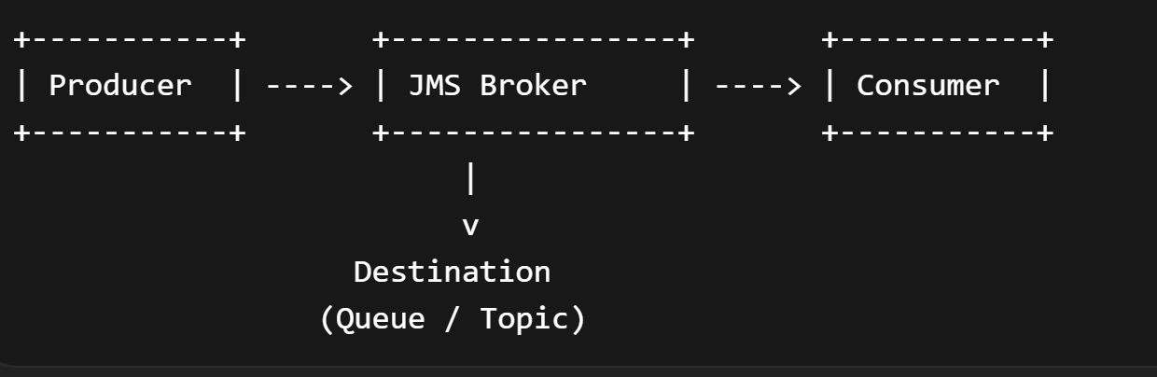
Core JMS model
There are four main players:
Producer -> sends message Broker -> stores/routes message Destination -> queue or topic Consumer -> receives message

Slide 9
Queue
Queue = point-to-point
A queue is used when one message should be consumed by one receiver.
Producer -> Queue -> one consumer gets it
If multiple consumers are listening, the broker distributes messages among them.
Use cases:
order processing
payment jobs
inventory updates
task queues

Slide 10
Queue
Producer -> OrderQueue -> Consumer A -> Consumer B
But each individual message goes to only one consumer.

Slide 11
Topic = publish-subscribe
A topic is used when one message should go to multiple subscribers.
Producer -> Topic -> Consumer A -> Consumer B -> Consumer C
Use cases:
business events
notifications
analytics feeds
cache invalidation events
So:
Queue = one receiver
Topic = many receivers

Slide 12
What makes JMS asynchronous?
A JMS sender typically does this:
jmsTemplate.convertAndSend("orderQueue", order);
After sending, the sender can continue immediately.
It does not need to know:
when consumer receives it
which server processes it
how long processing takes
whether receiver is temporarily busy
The broker handles storage and delivery.
That is why it is asynchronous.

Slide 13
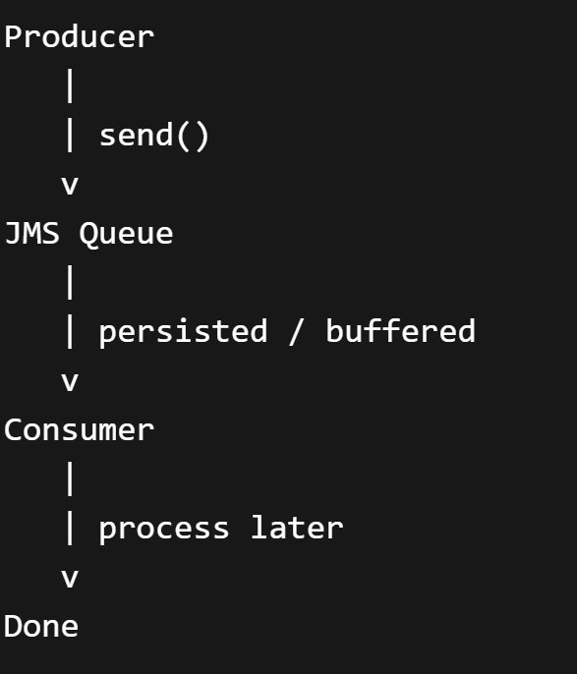
Message flow in asynchronous JMS
Here’s the lifecycle.
1. Producer creates message 2. Producer sends to queue/topic 3. Broker stores message 4. Producer continues 5. Consumer receives message later 6. Consumer processes it 7. Consumer acknowledges success/failure

Slide 14
Real-world example
Imagine an e-commerce app.
When user places an order, you may not want the REST API to do all work inline.
Instead:
REST API -> create order -> send JMS message -> return "Order accepted"
Then background consumers do:
payment validation
inventory reservation
email notification
shipment workflow
Now the order API is faster and less tightly coupled.

Slide 15
JMS producer
A producer sends messages to a destination.
Historically in JMS API you work with:
ConnectionFactory
Connection
Session
MessageProducer
In Spring apps, you usually use JmsTemplate.

Slide 16
JMS producer
Example:
jmsTemplate.convertAndSend("orderQueue", order);
What happens:
object gets converted into a JMS message
broker receives message
queue stores it
consumer gets it later

Slide 17
JMS consumer
A consumer receives messages from a destination.
There are two major consumption styles:
A. Synchronous receive
B. Asynchronous listener

Slide 18
JMS consumer - Synchronous receive
Consumer explicitly polls or blocks waiting:
Message message = consumer.receive();
This is technically possible, but it is not the usual app-level pattern for scalable enterprise apps.

Slide 19
JMS consumer -- Asynchronous listener
A listener is registered, and broker/container delivers messages when available.
In Spring:
@JmsListener(destination = "orderQueue") public void handleOrder(Order order) { System.out.println("Received: " + order); }
This is the most common style.
This is what people usually mean by asynchronous JMS consumption.

Slide 20
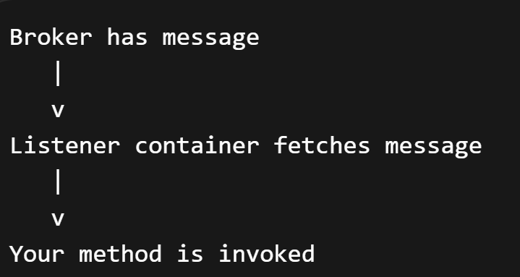
Push-style listener model
With listener-based consumption:
So your application is not manually polling in business code.

Slide 21
Spring’s listener
Spring’s listener container manages:
consumer threads
session handling
message conversion
acknowledgement
retries / error behavior depending on config

Slide 22
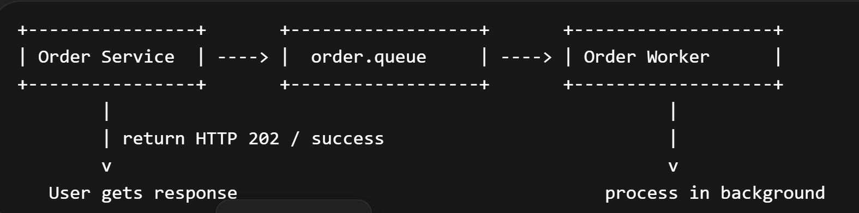
Queue-based async messaging
Classic point-to-point async pattern.

Slide 23
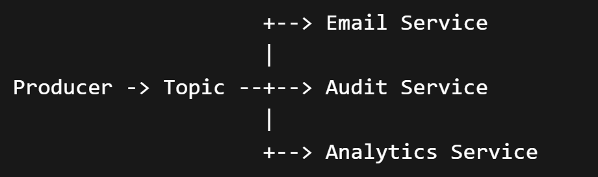
Topic-based async messaging
pub-sub
A single event can fan out to many consumers independently.

Slide 24
Message persistence
One big strength of JMS systems is durability.
Messages can often be persistent, meaning the broker stores them reliably so they survive crashes or restarts depending on broker configuration.
Why this matters:
sender can send and move on
broker safely holds message
consumer can process later
temporary outages are tolerated better
Without persistence, async messaging is much weaker for critical business workflows.

Slide 25
Message acknowledgment
Once consumer gets a message, how does broker know whether processing succeeded?
That’s where acknowledgment comes in.
Basic idea:
message delivered
consumer processes it
consumer/session acknowledges success
broker removes message
If processing fails before ack, the message may be redelivered depending on configuration.

Slide 26
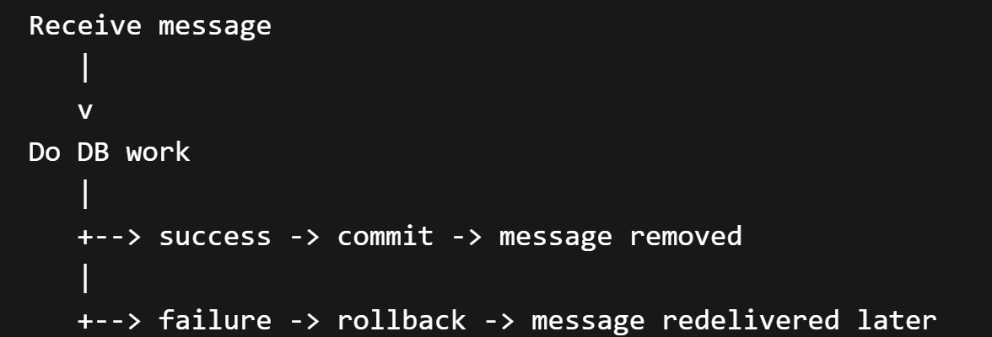
Transactions in JMS
Transactions are very important in asynchronous messaging.
A consumer often does something like:
receive message
update database
call business logic
commit
If transaction succeeds:
ack/commit message
remove from queue
If transaction fails:
rollback
message may be redelivered

Slide 27
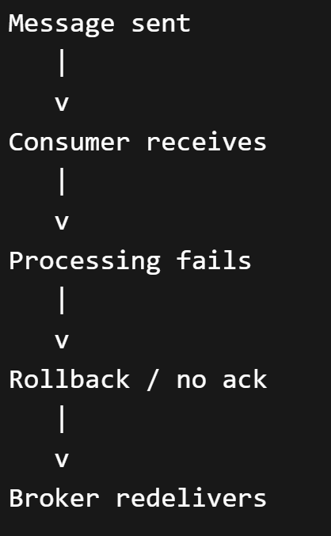
Redelivery
If processing fails, JMS broker may try again.
Great for transient failures, but dangerous if your processing is not idempotent.
Example danger:
consumer charges card
crashes before ack
message redelivered
card charged again
So async consumers should be designed carefully.

Slide 28
Idempotency
Because messages can be retried or duplicated, consumers should ideally be idempotent.
Meaning: processing the same message twice should not corrupt business state
Examples:
use unique order event IDs
store processed-message IDs
use deduplication checks
make operations safe on repeat
Without idempotency, async messaging gets risky in real systems.

Slide 29
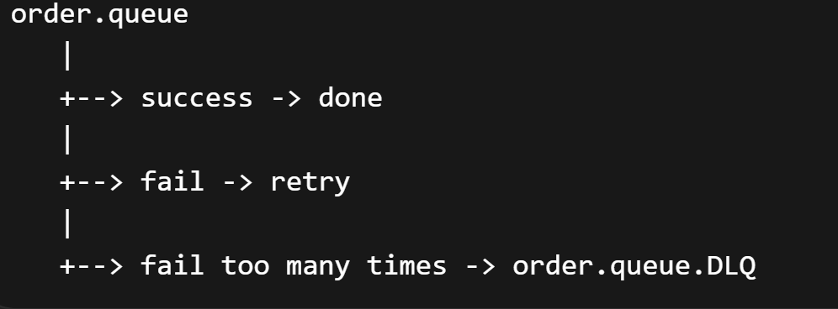
Dead letter queue (DLQ)
What if a message keeps failing over and over?
You don’t want infinite retries forever.
So brokers often support a Dead Letter Queue.
Flow:
Main Queue -> consumer fails repeatedly -> DLQ
Now bad messages are isolated for investigation.
DLQs are essential in production systems.

Slide 30
Load leveling
One major async benefit is load leveling.
Suppose producers send 10,000 requests quickly.
Without a queue:
downstream service gets overloaded immediately
With JMS:
messages pile up in queue
consumers process at steady pace
Traffic spike -> Queue buffers -> workers drain gradually
This protects downstream systems and smooths traffic bursts.

Slide 31
Competing consumers
With queues, you can scale by adding multiple consumers.
Producer -> Queue -> Consumer 1 -> Consumer 2 -> Consumer 3
Each message still goes to only one consumer, but total throughput increases.
This is called the competing consumers pattern.
Very common in enterprise integration.

Slide 32
Loose coupling
JMS async messaging gives loose coupling in several ways:
Time decoupling -Sender and receiver need not be active together.
Technology decoupling -Systems interact through messages, not direct method calls.
Location decoupling -Sender doesn’t care which machine handles processing.
Rate decoupling -Sender and receiver can operate at different speeds.
That is why message-oriented systems are so powerful.

Slide 33
Typical JMS message types
At API level, JMS supports message forms like:
TextMessage
ObjectMessage
BytesMessage
MapMessage
StreamMessage
In Spring, you often don’t deal with these directly because JmsTemplate and converters abstract them.
But conceptually the broker is carrying messages, not Java method calls.

Slide 34
Producer side
@Service
public class OrderPublisher {
private final JmsTemplate jmsTemplate;
public OrderPublisher(JmsTemplate jmsTemplate) {
this.jmsTemplate = jmsTemplate;
}
public void publish(Order order) {
jmsTemplate.convertAndSend("order.queue", order);
}
}

Slide 35
Consumer side
@Component
public class OrderConsumer {
@JmsListener(destination = "order.queue")
public void consume(Order order) {
System.out.println("Processing order: " + order);
}
}

Slide 36
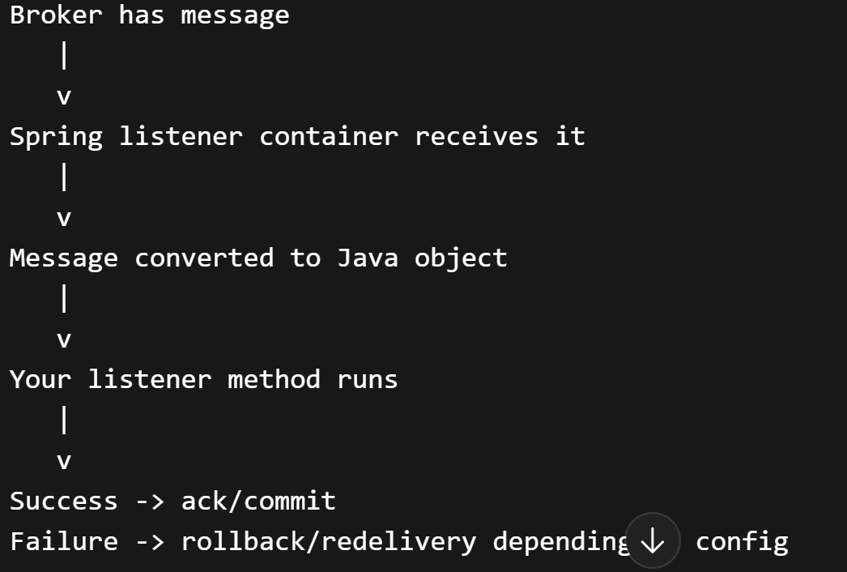
When using @JmsListener:

Slide 37
Request/reply vs pure async messaging
Pure asynchronous messaging
Sender sends and moves on.
send -> done
No immediate reply expected.
Request/reply over JMS
Sender sends a message and later expects a response message, often using JMSReplyTo and correlation IDs.
That is possible, but it is more complex and is not the same as pure async fire-and-forget messaging.
So when people say “asynchronous messaging with JMS,” they often mean:
queue/topic based decoupled communication
no immediate response in same call path

Slide 38
Correlation ID
In more advanced JMS flows, correlation IDs are used to match replies or related messages.
Example:
Request message -> CorrelationId = 123 Reply message -> CorrelationId = 123
This helps track conversations across async boundaries.
Very important for:
request/reply over JMS
saga workflows
tracing
distributed debugging

Slide 39
Reliability tradeoff
Async JMS gives strong decoupling, but it changes system behavior.
So async messaging is powerful, but not “free.”
Gain | Complexities
resilience scalability buffering loose coupling | eventual consistency duplicate handling retry complexity operational monitoring needs message ordering concerns DLQ management

Slide 40
When to use asynchronous JMS
Use it when:
work does not need immediate completion before responding
systems should be decoupled
traffic spikes need buffering
background processing is needed
reliable inter-system communication matters
retries and durability are important
Examples:
order submitted → process later
user signup → send welcome mail async
invoice generation
audit/event publishing
batch task distribution

Slide 41
When not to use it
Avoid using async JMS when:
caller truly needs immediate synchronous result
workflow is very simple and direct call is enough
eventual consistency is unacceptable
operational overhead is not justified
debugging complexity would outweigh benefit
Not every problem needs a queue.
That’s a very important architecture lesson.

Slide 42
Summary
Asynchronous messaging with JMS is a communication style where a producer sends a message to a JMS destination such as a queue or topic through a broker, and the consumer processes it independently at a later time.
Sender and receiver are decoupled in time, execution, and often scale.
JMS enables reliable delivery, persistence, transactions, acknowledgments, retries, and patterns such as point-to-point queues and publish-subscribe topics.
Commonly used for background processing, load leveling, system integration, and event-driven workflows.

Slide 43
Order Processing System
A REST API receives orders → sends them to a JMS queue → backend processes asynchronously.
REST Controller → Gateway → Channel → JMS Outbound Adapter (Queue) ↓ JMS Listener (Inbound Adapter) ↓ Service Activator (Process Order)
JMS queues (point-to-point)
Decoupling using messaging
Async processing
Gateway usage
E-commerce app where order placement should not block the UI

Slide 44
Email Notification System (Event-Driven)
Whenever an event (like user registration) happens → send a JMS message → email service consumes it and sends email.
User Service → Gateway → JMS Queue (event: USER_REGISTERED) ↓ JMS Listener → Transformer → Service Activator ↓ Email Sender
Event-driven architecture
Message transformation
Loose coupling between services
Send welcome email, OTP, alerts

Slide 45
Log Aggregation / Audit System
Multiple services send logs/events → JMS topic → central service consumes and stores logs in DB.
Multiple Producers → JMS Topic (Publish/Subscribe) ↓ Multiple Consumers (Audit Service, Monitoring Service) ↓ Store in DB / Print Logs
JMS Topics (pub-sub model)
Multiple consumers
Scalability pattern
Example Use Case
Centralized logging system
Audit trail system

Slide 46
RabbitMq
RabbitMQ is a message broker
where producers send messages to exchanges,
exchanges route messages to queues using routing rules,
and consumers process messages from queues with reliability features like acknowledgements, durability, and dead-letter handling.

Slide 47
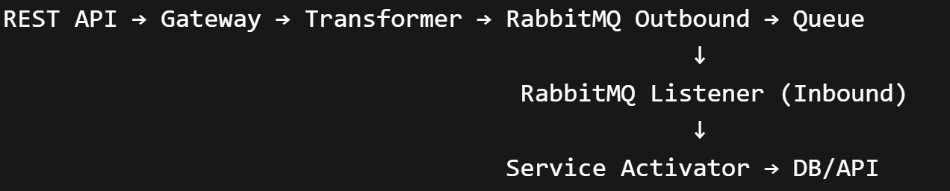
What is RabbitMQ Integration with Spring Integration?
RabbitMQ is a message broker (AMQP-based), and Spring Integration provides adapters to connect your integration flows to it.
In simple terms:
Spring Integration = orchestration layer RabbitMQ = transport layer

Slide 48
Key Components in Spring Integration (RabbitMQ)
Spring Integration provides AMQP adapters:
1. Outbound Adapter (Producer)
Sends messages to RabbitMQ exchange
Converts Spring Message → AMQP message
2. Inbound Adapter (Consumer)
Listens to queue
Converts AMQP → Spring Message

Slide 49
Outbound Adapter (Producer)
@Bean
public IntegrationFlow outboundFlow() {
return IntegrationFlow.from("inputChannel")
.handle(Amqp.outboundAdapter(rabbitTemplate())
.exchangeName("orders.exchange")
.routingKey("orders.key"))
.get();
}
Inbound Adapter (Consumer)
@Bean
public IntegrationFlow inboundFlow(ConnectionFactory connectionFactory) {
return IntegrationFlow
.from(Amqp.inboundAdapter(connectionFactory, "orders.queue"))
.handle(message -> System.out.println("Received: " + message))
.get();
}

Slide 50
Core RabbitMQ Concepts
Concept | Meaning
Exchange | Routes messages
Queue | Stores messages
Binding | Connects exchange → queue
Routing Key | Determines routing
Consumer | Reads messages

Slide 51
Exchange Types
Direct → exact match routing
Topic → pattern-based routing
Fanout → broadcast
Headers → metadata-based

Slide 52
Features of RabbitMQ (with Spring Integration)
✅ Messaging Patterns
Point-to-point
Publish/Subscribe
Request/Reply
✅ Reliability
Acknowledgements
Dead Letter Queues (DLQ)
Retry mechanisms
✅ Flexible Routing
Topic-based routing
Content-based routing
✅ Message Conversion
JSON, String, Serializable
Custom converters (important for your JMS error case!)

Slide 53
RabbitMQ
Key Reason to Prefer RabbitMQ
👉 JMS is just an abstraction 👉 RabbitMQ is a real, modern, feature-rich broker
When RabbitMQ Wins
Complex routing (topic/fanout)
Microservices communication
Cloud-native systems
Event-driven architecture

Slide 54
Advantages of RabbitMQ
1. Easy to Use
Quick setup
Works well with Spring Boot auto-config
2. Powerful Routing
Exchange-based routing is very flexible
3. Reliability
Message persistence
DLQ support
4. Great Spring Support
Spring AMQP + Spring Integration
5. Lightweight
Faster to get started than Kafka

Slide 55
Disadvantages of RabbitMQ
1. Not ideal for high-throughput streaming
Kafka is better for big data pipelines
2. Queue-based (not log-based)
Messages are removed after consumption
3. Scaling limitations
Horizontal scaling is harder than Kafka

Slide 56
Use Cases
🛒 1. Order Processing System
Order placed → Queue → Payment → Shipping
📧 2. Email Notifications
Async email sending
🔄 3. Microservices Communication
Service A → Queue → Service B
📦 4. Task Queues / Background Jobs
Image processing
Report generation
🔁 5. Retry / DLQ Patterns
Failed payments → DLQ → Retry later

Slide 57
Final Summary
Use RabbitMQ + Spring Integration when:
You need asynchronous communication
You want clean integration flows
You need routing flexibility
Prefer over JMS when:
You want modern architecture
You need better routing + scalability
You don’t want vendor lock-in
Prefer Kafka when:
You need event streaming
You need message replay
You handle big data / analytics

Slide 58
RabbitMQ
At its core, RabbitMQ is a message routing system, not just a queue.
Producer → Exchange → Queue → Consumer
Key idea: Producer never sends directly to a queue — it sends to an Exchange

Slide 59
Producer
The application that sends messages
In Spring: RabbitTemplate or outbound adapter
rabbitTemplate.convertAndSend("exchange", "routingKey", message);
Application produce events/messages"

Slide 60
Consumer
The application that receives messages
In Spring: @RabbitListener or inbound adapter
@RabbitListener(queues = "orders.queue") public void handle(String message) { System.out.println(message); }

Slide 61
Exchange
This is where RabbitMQ becomes powerful.
Exchange = Router
Receives messages from producer
Decides which queue(s) should get the message

Slide 62
Types of Exchanges
1. Direct Exchange
2. Topic Exchange
3. Fanout Exchange
4. Header Exchange

Slide 63
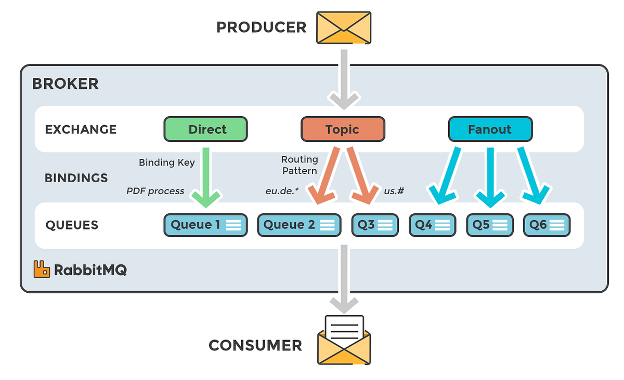

Slide 64
Direct Exchange
Routes based on exact routing key match
routingKey = "order.created"
Use when:
Exact routing needed

Slide 65
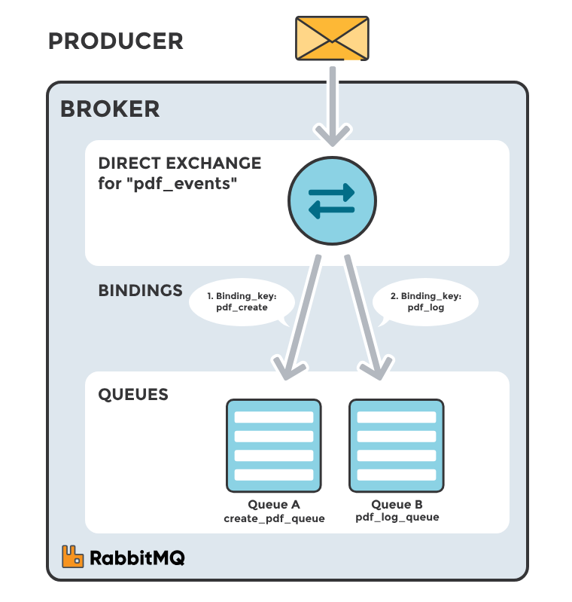

Slide 66
Topic Exchange
Uses wildcards
* → one word
# → multiple words
order.* → order.created, order.updated order.# → order.created.us, order.updated.eu
Use when:
Flexible routing needed

Slide 67
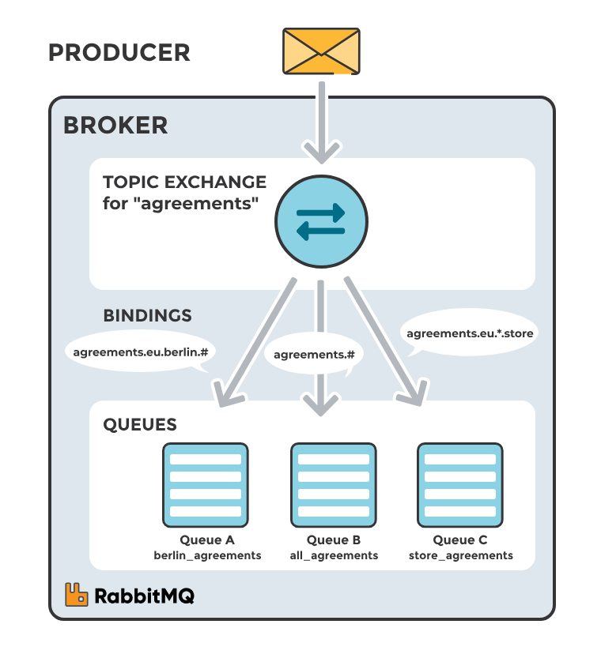

Slide 68
Fanout Exchange
Sends message to ALL bound queues
Ignores routing key
Use when:
Broadcast (pub/sub)

Slide 69
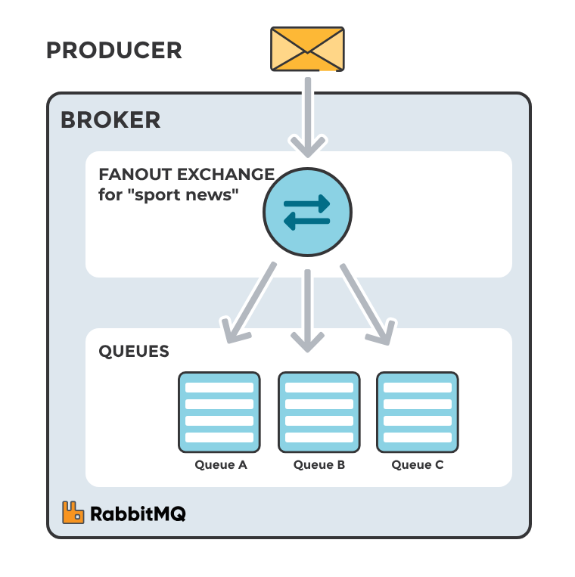

Slide 70
Headers Exchange
Routes based on message headers
Not commonly used
Use when:
Routing depends on metadata

Slide 71
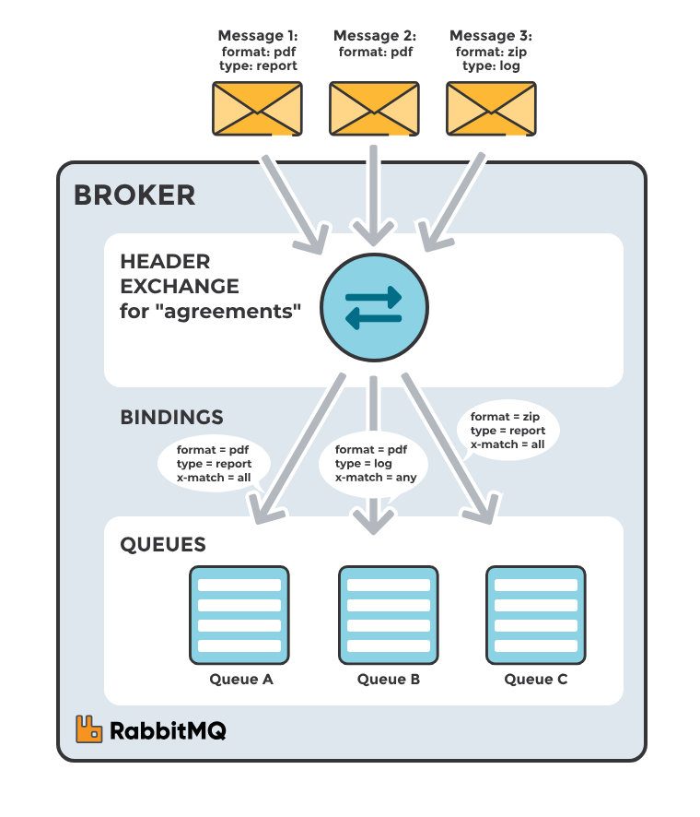

Slide 72
Queue
Stores messages until consumed
Key properties:
Durable (survives restart)
Exclusive (used by one consumer)
Auto-delete
Messages sit in queue until consumed (FIFO-ish, but not strict)

Slide 73
Routing Key
A string sent with message
Used by exchange to route
"order.created" "payment.failed"

Slide 74
Message
A message consists of:
Payload → actual data
Headers → metadata
Properties → delivery mode, priority, etc.

Slide 75
Binding
Connection between Exchange → Queue
Exchange + Routing Key → Queue
Think:
"Rule that defines where messages go“
Binding = a rule that connects an Exchange to a Queue
It tells RabbitMQ: “If a message comes with this routing key → send it to this queue”
Producer → Exchange → (Binding) → Queue → Consumer

Slide 76
How Binding Actually Works
Conceptual View
Producer sends message → Exchange
Exchange checks bindings
Based on rules → message goes to queue(s)
Real-Life Analogy
Think of a postal sorting center:
Producer = person sending parcel
Exchange = sorting office
Binding = sorting rule
Queue = mailbox
Consumer = receiver
Binding = “All parcels with ZIP code 600001 → go to this mailbox”

Slide 77
Example
Exchange: orders.exchange Queue: orders.queue Binding: routingKey = "order.created"
Flow:
Producer sends → "order.created" Exchange checks binding → Matches → Message goes to orders.queue → Consumer receives it

Slide 78
Spring Boot / Spring Integration Example
@Bean
public Queue queue() {
return new Queue("orders.queue");
}
@Bean
public DirectExchange exchange() {
return new DirectExchange("orders.exchange");
}
@Bean
public Binding binding(Queue queue, DirectExchange exchange) {
return BindingBuilder
.bind(queue)
.to(exchange)
.with("order.created");
}
What this does:
Bind orders.queue → orders.exchange Using routing key → "order.created"

Slide 79
End-to-End Flow with Binding
1. Producer sends message: routingKey = "order.created" 2. Exchange receives message 3. Exchange checks bindings: - Does any queue have binding "order.created"? ✅ YES 4. Message routed to that queue 5. Consumer reads from queue

Slide 80
Binding
Binding in RabbitMQ is the relationship between an exchange and a queue
that defines how messages are routed.
Specifies the routing rules, typically using a routing key or pattern, so that when a producer sends a message to an exchange,
the exchange uses the binding to decide which queue(s) should receive that message.

Slide 81
Core Concepts
Concept | What it is | Who defines it | Purpose
Exchange | Router | System config | Decides where messages go
Routing Key | Message label | Producer | Helps in routing
Binding | Rule | System config | Matches routing key → queue

Slide 82
Summary
Exchange acts as a router that receives messages from producers.
Routing key is a label attached to the message,
Binding is a rule that connects an exchange to a queue.
Exchange uses the routing key and compares it with binding rules to decide which queue or queues should receive the message.

Slide 83
Important Note
One message can go to multiple queues
Why? Multiple bindings can match the same routing key
Example:
Queue A binding: order.* Queue B binding: order.created Routing Key: order.created
✔ Both queues receive the message

Slide 84
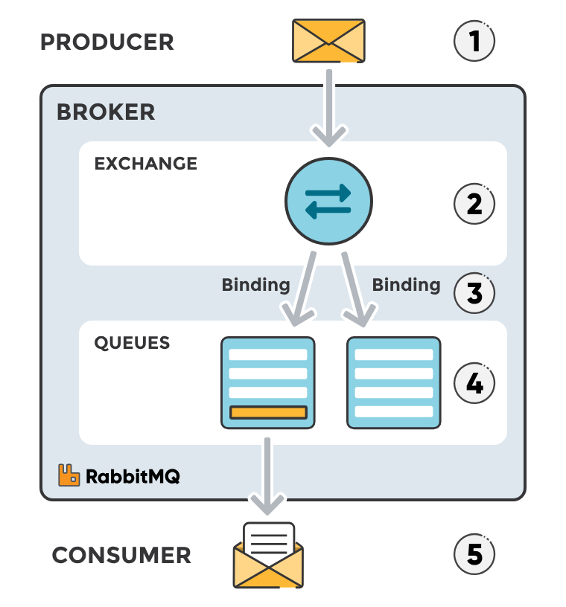

Slide 85
Acknowledgement (ACK)
Consumer confirms message processed
Types:
Auto ACK → automatic
Manual ACK → safer
channel.basicAck(deliveryTag, false);
Why important:
Prevents message loss

Slide 86
Message Durability & Persistence
Durable Queue =Survives restart
Persistent Message =Stored on disk
Both needed for full reliability

Slide 87
Prefetch Count
Controls how many messages a consumer gets at once
factory.setPrefetchCount(10);
Prevents: Overloading consumers

Slide 88
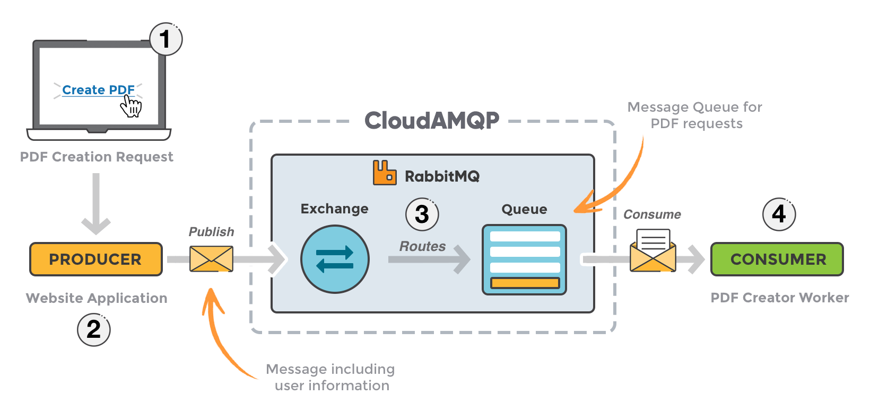

Slide 89
Topic Example
Producer → Topic Exchange → (Binding rules) → Queue(s) → Consumer
Scenario:
Exchange: orders.exchange (Topic)
Queue 1: orders.created.queue
Queue 2: orders.all.queue
Binding rules
orders.created.queue → order.created orders.all.queue → order.*
Routing Key | Goes to Queue
order.created | BOTH queues
order.updated | orders.all.queue
payment.created | NONE

Slide 90
// Queues @Bean public Queue createdQueue() { return new Queue("orders.created.queue"); } @Bean public Queue allOrdersQueue() { return new Queue("orders.all.queue"); }
// Topic Exchange @Bean public TopicExchange exchange() { return new TopicExchange("orders.exchange"); }
// Bindings @Bean public Binding bindingCreated(Queue createdQueue, TopicExchange exchange) { return BindingBuilder.bind(createdQueue) .to(exchange) .with("order.created"); } @Bean public Binding bindingAll(Queue allOrdersQueue, TopicExchange exchange) { return BindingBuilder.bind(allOrdersQueue) .to(exchange) .with("order.*"); }

Slide 91
Producer (Send Message)
@Service
public class OrderProducer {
@Autowired
private RabbitTemplate rabbitTemplate;
public void send(String routingKey, String message) {
rabbitTemplate.convertAndSend(
"orders.exchange",
routingKey,
message
);
}
}

Slide 92
Consumers
@Component
public class OrderConsumers {
@RabbitListener(queues = "orders.created.queue")
public void handleCreated(String message) {
System.out.println("Created Queue Received: " + message);
}
@RabbitListener(queues = "orders.all.queue")
public void handleAll(String message) {
System.out.println("All Orders Queue Received: " + message);
}
}

Slide 93
@RestController
public class TestController {
@Autowired
private OrderProducer producer;
@GetMapping("/send")
public String send() {
producer.send("order.created", "Order Created!");
producer.send("order.updated", "Order Updated!");
return "Messages sent!";
}
}
Case 1:
routingKey = order.created
✔ Matches:
order.created
order.*
👉 Goes to BOTH queues
Case 2:
routingKey = order.updated
✔ Matches:
order.*
👉 Goes to orders.all.queue only

Slide 94
Fan out Exchange

Slide 95
@Configuration
public class RabbitConfig {
// Queues
@Bean
public Queue queue1() {
return new Queue("fanout.queue1");
}
@Bean
public Queue queue2() {
return new Queue("fanout.queue2");
}
// Fanout Exchange
@Bean
public FanoutExchange fanoutExchange() {
return new FanoutExchange("fanout.exchange");
}
// Bindings
}
// Bindings (NO routing key needed)
@Bean
public Binding binding1(Queue queue1, FanoutExchange fanoutExchange) {
return BindingBuilder.bind(queue1).to(fanoutExchange);
}
@Bean
public Binding binding2(Queue queue2, FanoutExchange fanoutExchange) {
return BindingBuilder.bind(queue2).to(fanoutExchange);
}

Slide 96
Producer
@Configuration
@EnableIntegration
public class FanoutIntegrationConfig {
@Bean
public DirectChannel inputChannel() {
return new DirectChannel();
}
@Bean
public IntegrationFlow fanoutOutboundFlow(RabbitTemplate rabbitTemplate) {
return IntegrationFlows.from("inputChannel")
.handle(Amqp.outboundAdapter(rabbitTemplate)
.exchangeName("fanout.exchange"))
.get();
}
}

Slide 97
Consumer1
@Bean
public IntegrationFlow queue1Flow(ConnectionFactory connectionFactory) {
return IntegrationFlows
.from(Amqp.inboundAdapter(connectionFactory, "fanout.queue1"))
.handle(msg -> System.out.println("Queue1 received: " + msg.getPayload()))
.get();
}

Slide 98
Consumer2
@Bean
public IntegrationFlow queue2Flow(ConnectionFactory connectionFactory) {
return IntegrationFlows
.from(Amqp.inboundAdapter(connectionFactory, "fanout.queue2"))
.handle(msg -> System.out.println("Queue2 received: " + msg.getPayload()))
.get();
}

Slide 99
Consumer
@Component
public class FanoutConsumers {
@RabbitListener(queues = "fanout.queue1")
public void consumeFromQueue1(String message) {
System.out.println("Queue1 received: " + message);
}
@RabbitListener(queues = "fanout.queue2")
public void consumeFromQueue2(String message) {
System.out.println("Queue2 received: " + message);
}
}

Slide 100
Expected Behavior

